Slide 1
A Survey on Predicting Generalization in Deep Learning (PGDL) Competition
Jiaxi Zhao NUS
Sep 2021

Slide 2
Overview of the competition design¹
Data point: trained network with unknown algorithm
Sequential (no skip-connection)
Trained until they reach the interpolation regime
Architecture and trained weight provided
Two classed: VGG-like models and Network in network
Good performance in reality, interpolate fast while has large generalization error range, reasonable number of hyperparameter.
All the 8 tasks we considered in the competition are image recognition tasks with different variations of convolutional neural networks.

Slide 3
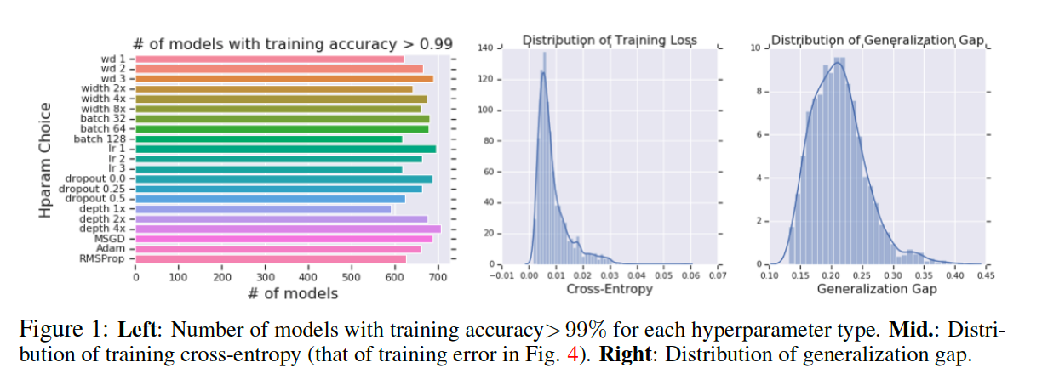
Overview of the competition design

Slide 4
Overview of the competition design
Phase 0: Public data was given to the competitors: test on Task 1 & 2.
Phase 1: First online leaderboard, accessible at the beginning of the competion (also called public leaderboard). This leaderboard is composed of Task 4 and Task 5 and was used to compute the scores displayed on the leaderboard for the first phase of the competition.
Phase 2: Private leaderboard, only accessible in the last phase of the competition, where competitors can upload their very best metrics. Winners are determined only on their score on this leaderboard (to prevent overfitting of the public leaderboard, as usual). This phase is composed of Task 6, Task 7, Task 8, and Task 9.

Slide 5
Examples of task (Task 1)
Model: VGG-like models, with 2 or 6 convolutional layers [conv-relu-conv-relu-maxpool] x 1 or x 3. One or two dense layers of 128 units on top of the model.When dropout is used, it is added after each dense layer.
Dataset: CIFAR-10 [15](10 classes, 3 channels).
Training: Trained for at most 1200 epochs, learning rate is multiplied by 0.2 after 300, 600 and 900 epochs. Cross entropy and SGD with momentum 0.9. Initial learning rate of 0.001
Hparams: Number of lters of the last convolutional layer in [256, 512]. Dropout probability in [0, 0.5]. Number of convolutional blocks in [1, 3]. Number of dense layers (excluding the output layer) in [1, 2]. Weight decay in [0.0, 0.001]. Batch size in [8, 32, 512].

Slide 6
Examples of task (Task 9)
Model: Network in Network.
Dataset: CIFAR-10, with the standard data augmentation (random horizontal and random crops after padding by 4 pixels.
Training: Trained for at most 1200 epochs, learning rate is multiplied by 0.2 after 300, 600 and 900 epochs. Cross entropy and SGD with momentum 0.9. Initial learning rate of 0.01.
Hparams: Number of lters in the convolutional layers in [256, 512], Number of convolutional layers in [9, 12], dropout probability in [0.0, 0.25], weight decay in [0.0, 0.001], batch size in [32, 512].

Slide 7
Three categories of generalization estimators
Principled complexity measures
Data augmentation
Intermediate Representation Analysis

Slide 8
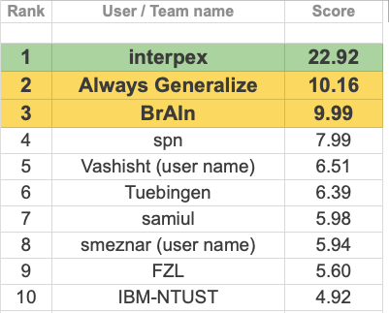
Winner of the competition²
Interpex
Always Generalize
BrAIn

Slide 9


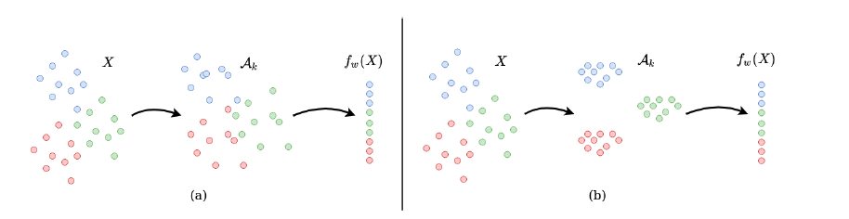
First Place: interpex³
Consistency

Slide 10


First Place: interpex
Robustness:
Use Mixup

Slide 11



First Place: interpex
Separability

Slide 12
Second Place: Always Generalize⁴
For every sample in a randomly sampled subset of the training set, the input is augmented with a collection of augmentations and the class prediction of each output is compared to that of the original image.
Sophisticated augmentation procedure provides better results.

Slide 13
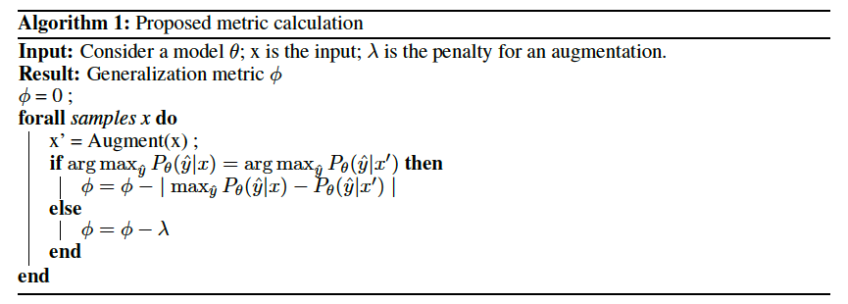
Second Place: Always Generalize

Slide 14
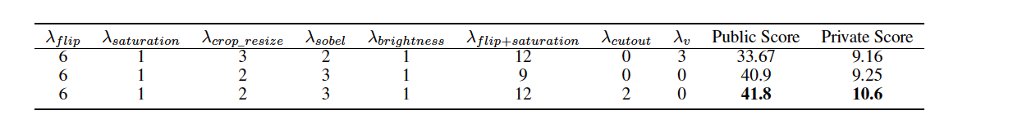
Second Place: Always Generalize
The penalty is determined based on the strength of the augmentation. The strength of augmentation is determined by the ability of the augmentation to change the texture in the input. Augmentations that do not alter the texture of the image, but to tend to alter the shape in the image, are weak.

Slide 15
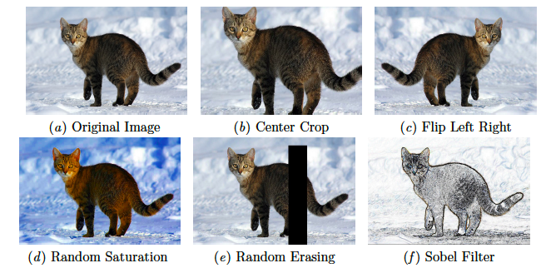
Second Place: Always Generalize
The list of augmentations used were Flip, Random Saturation, Crop and Resize, Brightness, Random Erasing (Zhong et al.), Sobel lter (Kanopoulos et al., 1988) and Virtual Adversarial Perturbation (Miyato et al., 2018).

Slide 16
Performance of theoretic bounds⁵
Failure of Norm & Margin-based measure
Success of Sharpness-based measure

Slide 17
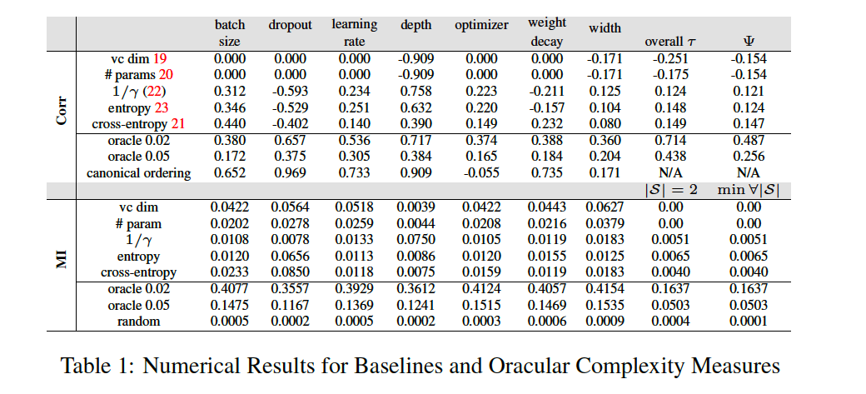
Performance of theoretic bounds

Slide 18
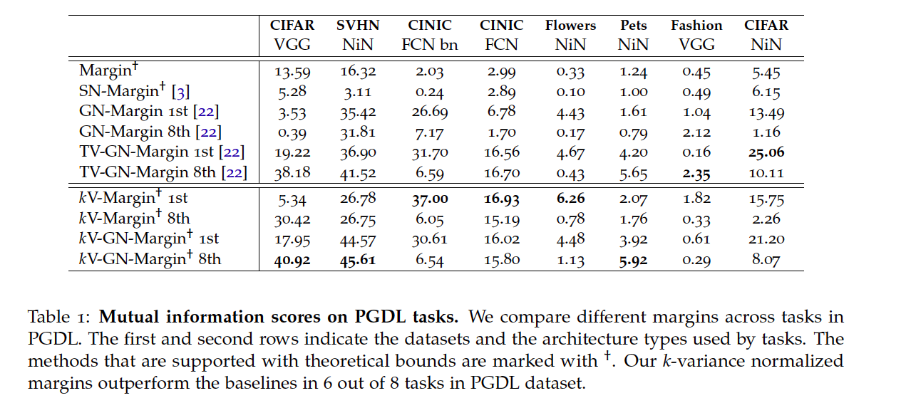
Performance of theoretic bounds(Margin)

Slide 19
References
Yiding Jiang, Pierre Foret, Scott Yak, Daniel M Roy, Hossein Mobahi, Gintare Karolina Dziugaite, Samy Bengio, Suriya Gunasekar, Isabelle Guyon, and Behnam Neyshabur. Neurips 2020 competition: Predicting generalization in deep learning. arXiv preprint arXiv:2012.07976, 2020.
Yiding Jiang*, Behnam Neyshabur*, Hossein Mobahi, Dilip Krishnan, and Samy Bengio. Fantastic generalization measures and where to nd them. In International Conference on Learning Representations, 2020.

Slide 20
References
Parth Natekar and Manik Sharma. Representation based complexity measures for predicting generalization in deep learning. arXiv preprint arXiv:2012.02775, 2020.
Sumukh Aithal K, Dhruva Kashyap, and Natarajan Subramanyam. Robustness to augmentations as a generalization metric, 2021.
Yiding Jiang, Pierre Foret, Scott Yak, Daniel M Roy, Hossein Mobahi, Gintare Karolina Dziugaite, Samy Bengio, Suriya Gunasekar, Isabelle Guyon, and Behnam Neyshabur. Methods and Analysis of The First Competition in Predicting Generalization of Deep Learning, Proceedings of Machine Learning Research 133:170{190, 2021 NeurIPS 2020 Competition and Demonstration Track

